Slide 1

Copy Writing: Newsletters for TheFitExpo

Slide 2
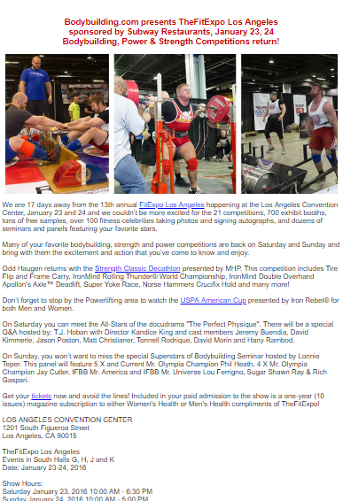

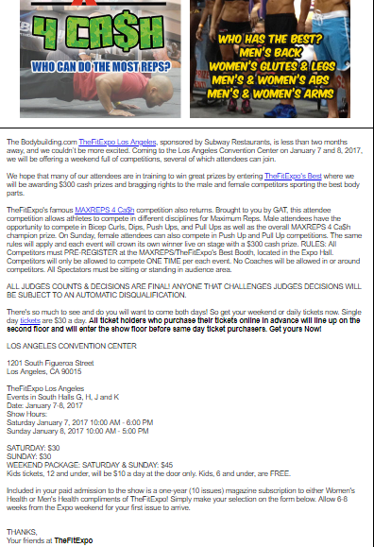

Slide 3

Copy Writing: Newsletters for The L.A. Office

Slide 4


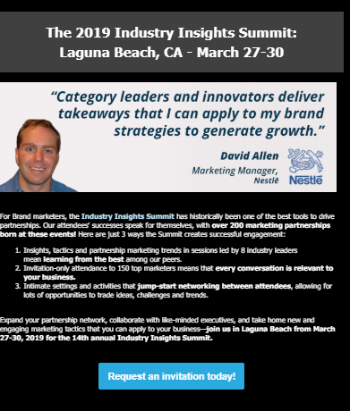

Slide 5

Copy Writing: Social Posts for Tune Up Fitness

Slide 6
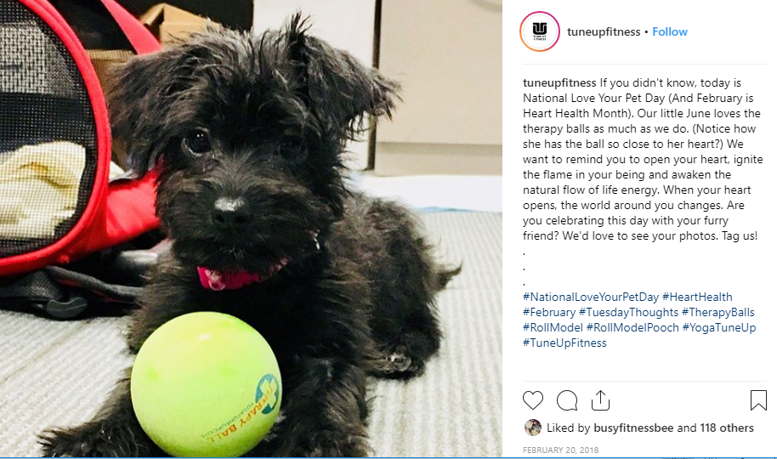
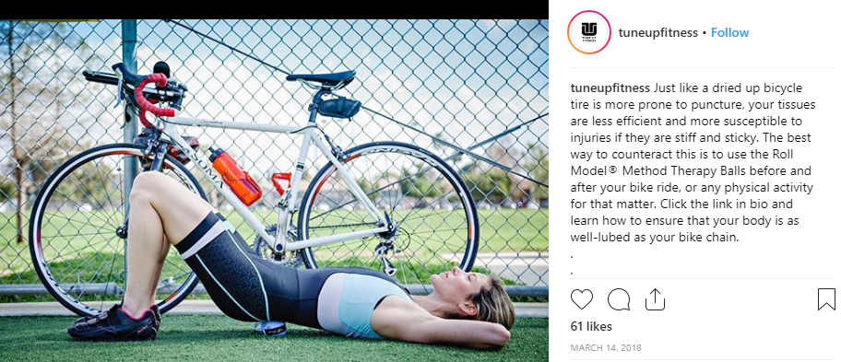

Slide 7

Copy Writing: Social Posts for Z Living Network

Slide 8
